Slide 1
ROAD ACCIDENT PROJECT
-by Rohit kumar

Slide 2
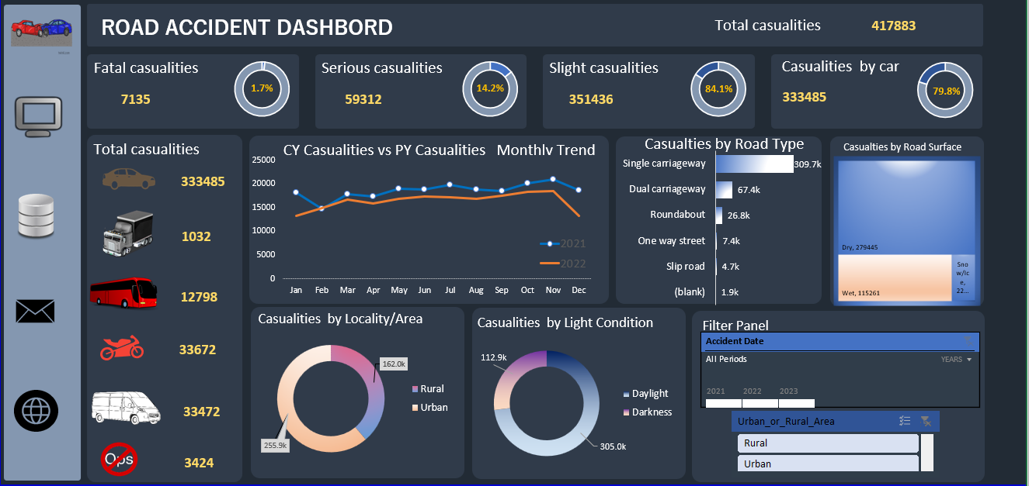
Using Excel

Slide 3
Insights
Key Insights from the Road Accident Data
High Casualty Count
Total casualties: 417,883
Slight injuries make up the majority: 84.1%
Serious casualties: 14.2%
Fatalities: 1.7%
Vehicle Type Involvement
Cars are involved in 79.8% of casualties (3.33 lakh)
Road Type and Conditions
Most accidents happen on single carriageways: 309.7k casualties
Wet roads have more accidents (115,261) compared to snow/ice (22k)
Dry roads still contribute the highest: 279,445 casualties
Area and Light Conditions
Urban areas see more casualties: 255.9k vs Rural: 162k
Daylight accidents dominate: 305k
But 112.9k accidents occur in darkness, showing a need for better night-time visibility and lighting
Monthly Trend (2021 vs 2022)
Casualties peak between May and October
2022 shows a slightly lower trend than 2021 in most months

Slide 4
Stakeholders
Ministry of Transport :
Improve Roads:
Prioritize upgrading single carriageways (309.7k casualties) to dual carriageways to reduce accident intensity.
Improve slip roads and roundabouts with clearer signage and road design improvements.
Policy and Regulation Updates:
Make sure cars meet strict safety standards since most accidents involve cars (around 80%).Promote safer vehicle
Focus on High-Risk Areas:
Target urban areas (255.9k casualties) with stricter enforcement and urban planning improvements.
Emergency Service Department
Better Placement of Ambulances:
Keep ambulances near busy city areas where accidents happen often.
Add more staff during months when accidents are usually high (like May to October).
Be Ready at Night:
Train teams and prepare equipment for night-time accidents (over 25% happen in the dark).

Slide 5
Traffic Management Agencies
Use Smart Systems:
Put up cameras and alert systems on dangerous roads, especially single-lane and wet roads.
Smart Patrol Planning:
Use data to decide where to send traffic police based on road type and accident records.
Teach Safe Driving:
Run campaigns to warn people about the dangers of speeding, not wearing seatbelts, and careless driving.
Public
Awareness Campaigns:
Educate people about wearing seatbelts, driving safely in the dark or on wet roads.
Focus more on city areas and accident-prone months.
Reporting Tools:
Let people report unsafe roads through mobile apps or helplines to help fix them faster.
Link : https://docs.google.com/spreadsheets/d/1QkST7GBXCg3nxzXk3P8ceHiOwdFAZdaz/edit?usp=sharing&ouid=103546839799177555715&rtpof=true&sd=true

